Slide 1
The first year of our incorporation...

Slide 2
Year that we started production for the first time.
We started ballast production.

Slide 3
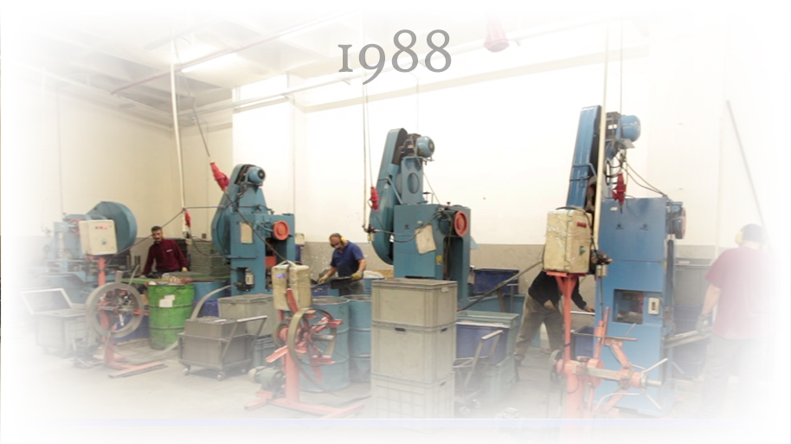
We established metal processing plant.

Slide 4
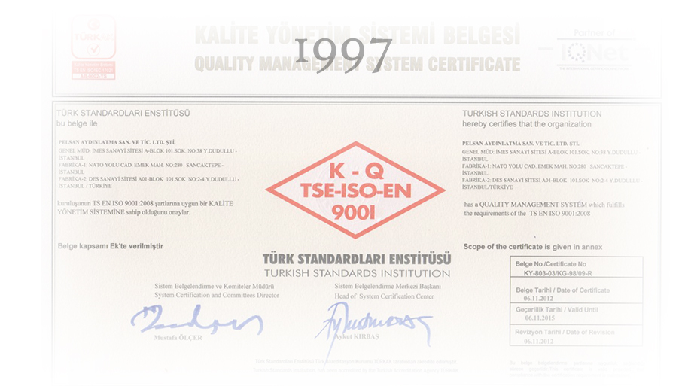
We adopted ISO 9001 quality system.

Slide 5
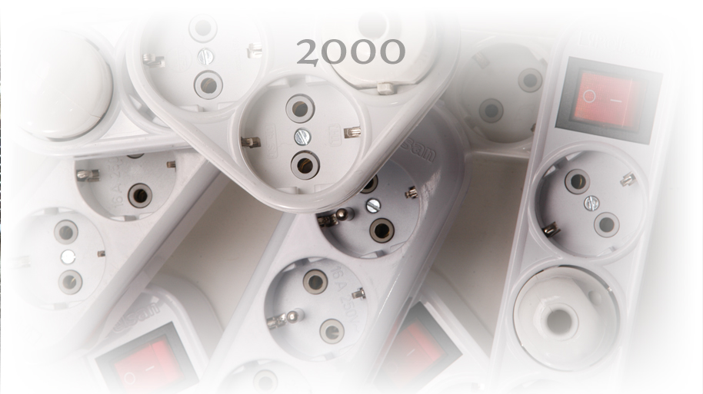
We started plastic injection production.

Slide 6
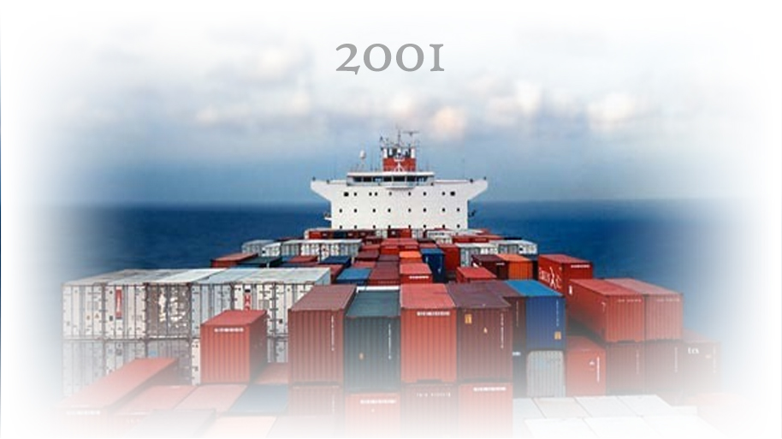
We performed our first export.

Slide 7
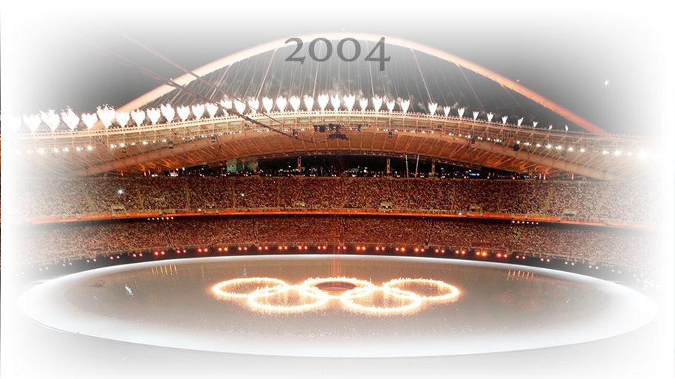
We illuminated Olympic Games in Athens.

Slide 8
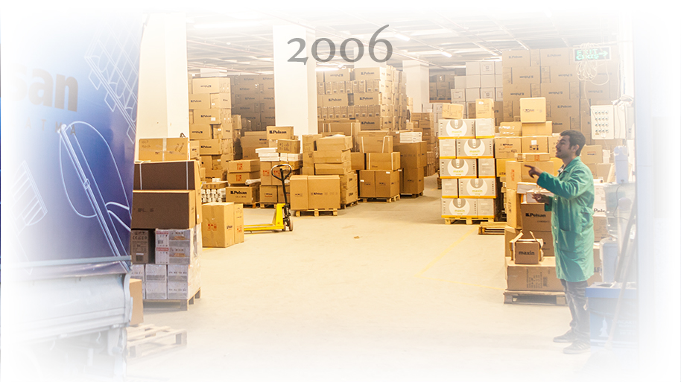
We established our logistics centre.

Slide 9
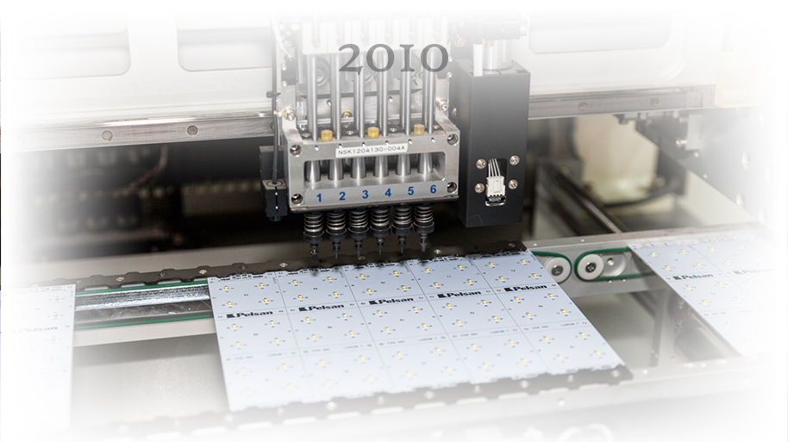
We established our electronics centre.

Slide 10
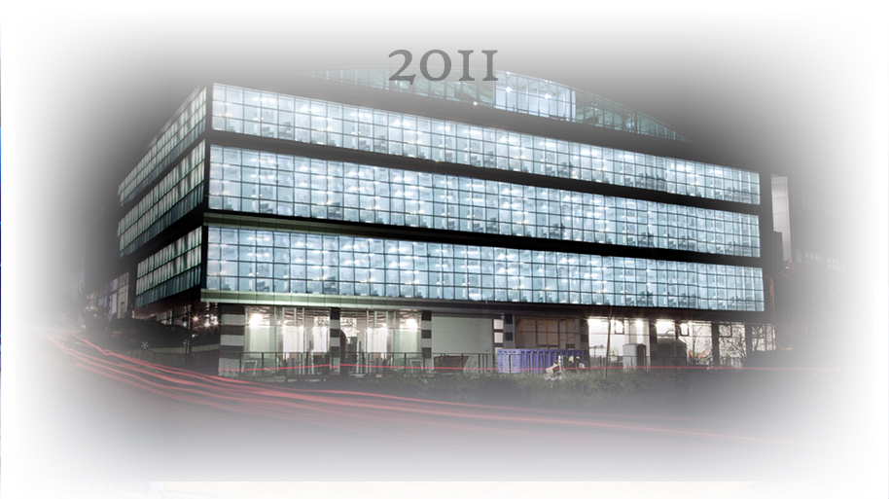
We moved to our current factory building.

Slide 11
We celebrated our 30th year in the industry.

Slide 12
We achieved integration among the units
with the ERP system.

Slide 13
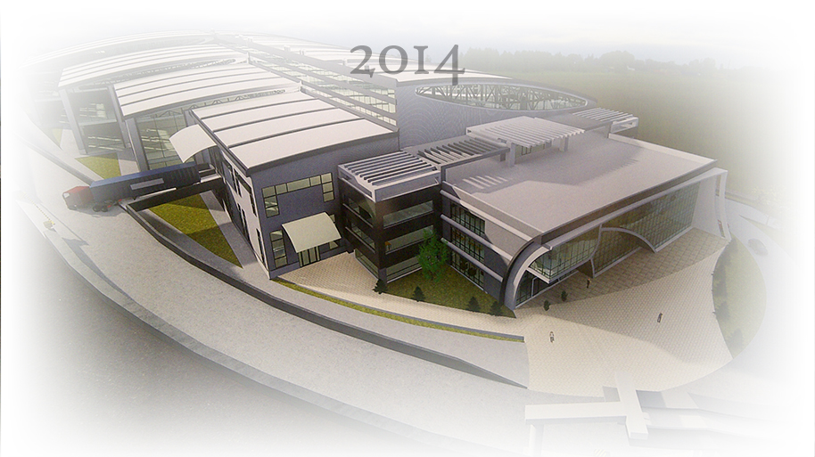
We laid foundations of our new factory.

Slide 14
We certify all of our lighting products with our laboratory accredited by Turkish Accreditation Institution.

