Slide 2
We were founded 34 years ago

Slide 3
We are one of the biggest manufacturers in the lighting industry in Turkey with our production, export and employment figures.

Slide 4
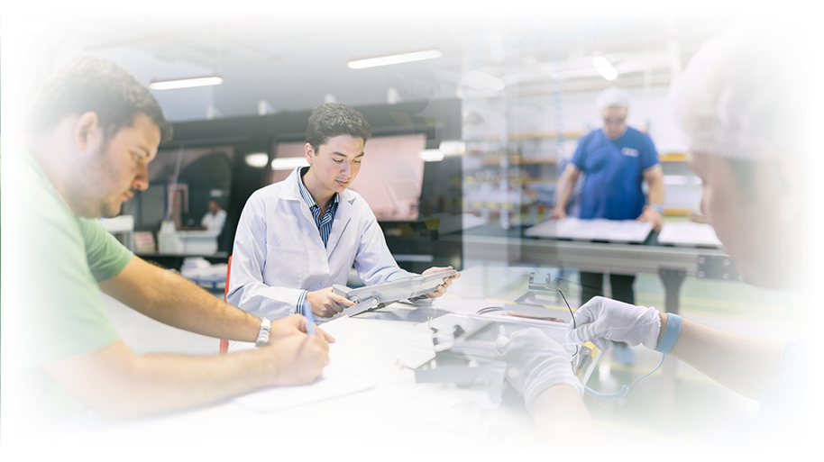
We perform production of lighting luminaries and equipment
at indoor area of 25.000m² with our 450 personnel.

Slide 5
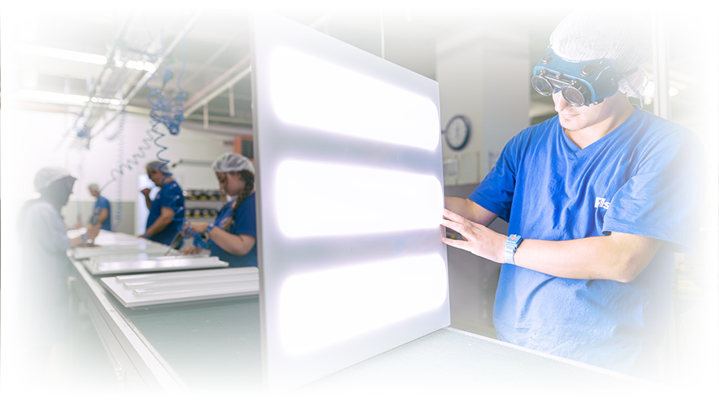
We produce 5 million lighting luminaries
per year at our facilities.

Slide 6
We export to 62 countries primarily to Europe.

Slide 7
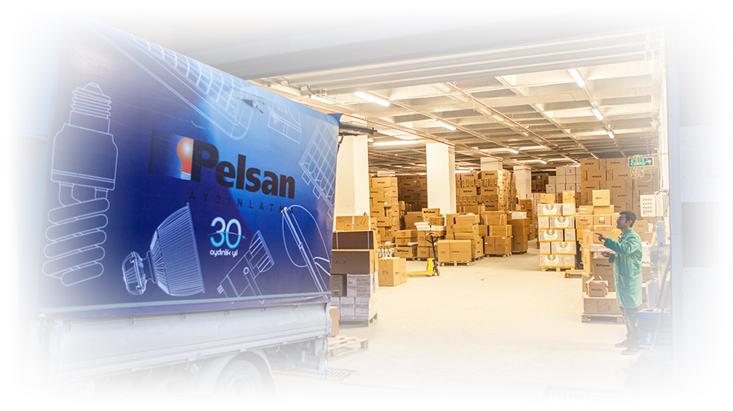
We deliver our products to our customers through our dealer network
in 60 provinces of Turkey, chain stores, Tedaş and projects.

Slide 8
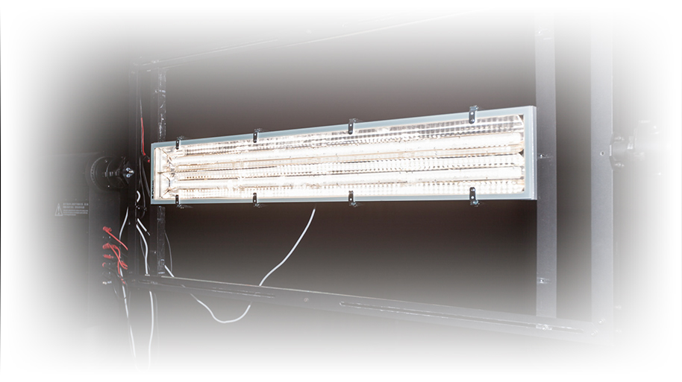
We achieve scientific studies in illumination area
with our strong engineer staff working at our R&D department.

Slide 9
We make optical, thermal, mechanical and electrical designs in the house and design luminaries that conform to lighting criteria
with our R&D studies and developing LED technology.

Slide 10
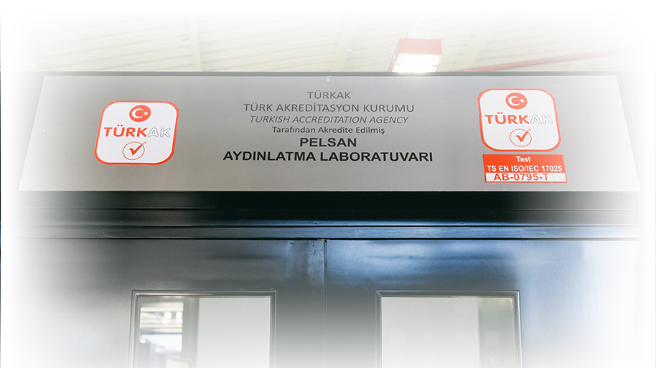
We certify all of our lighting products
with our laboratory accredited by Turkish Accreditation Institution.

Slide 11
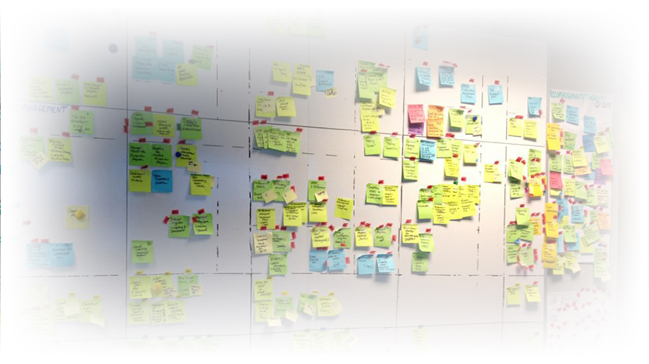
We carry out efficiency studies
with techniques such as kanban and 5S.

Slide 12
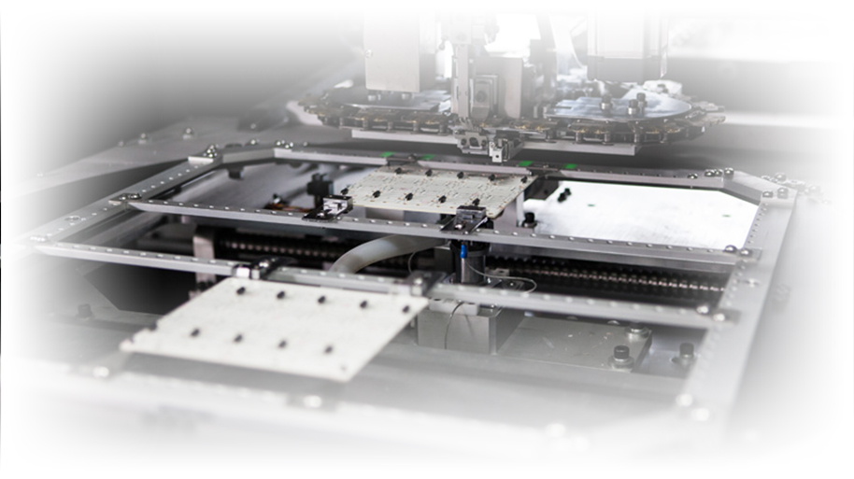
At our electronics department,
we ensure lighting & electronic integration with new technology LED.

Slide 13
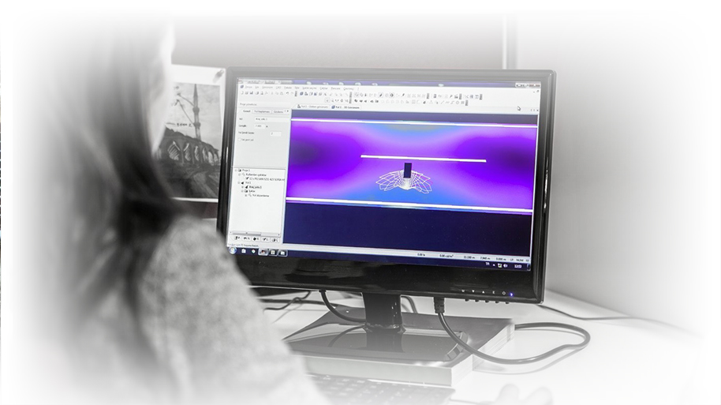
We offer project and lighting design service
special for venues with integrated saving approach.

Slide 14
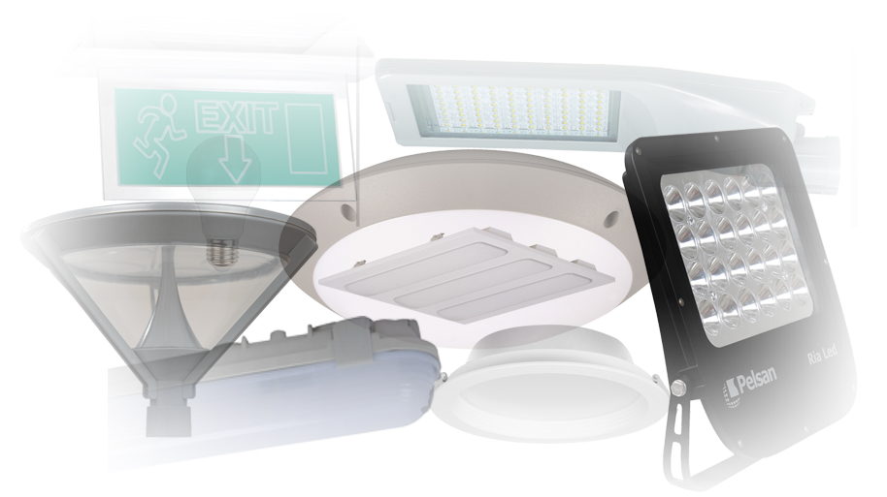
Our product range of 3000 varieties contains
Outdoor Lighting, Indoor Lighting, Industrial Lighting,
Equipment and Lamps.

Slide 15
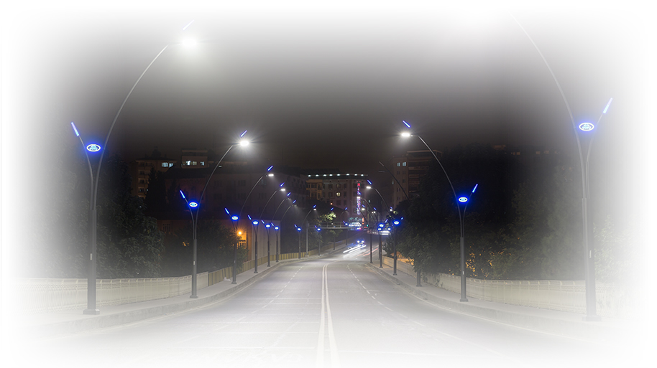
Outdoor Lighting Luminaries
Road, Avenue and Street Luminaries / Floodlights
Park and Garden Luminaries

Slide 16
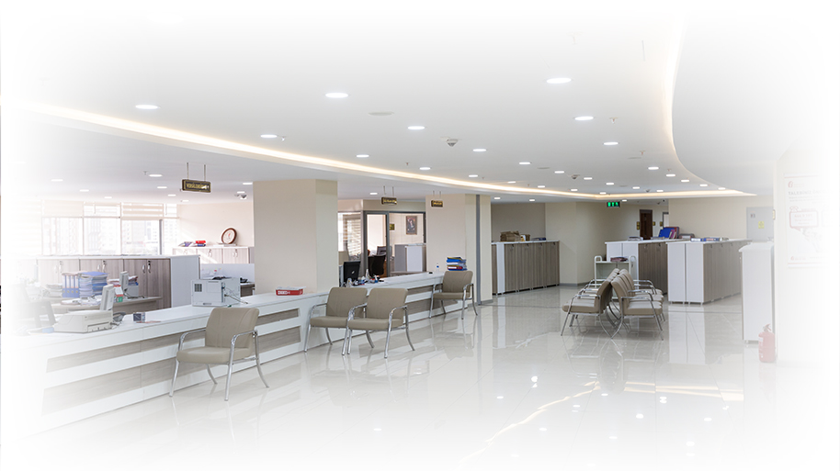
Indoor Lighting Luminaries
Office Luminaries / Store and Showcase Luminaries
Emergency Lighting and Signage Luminaries

Slide 17
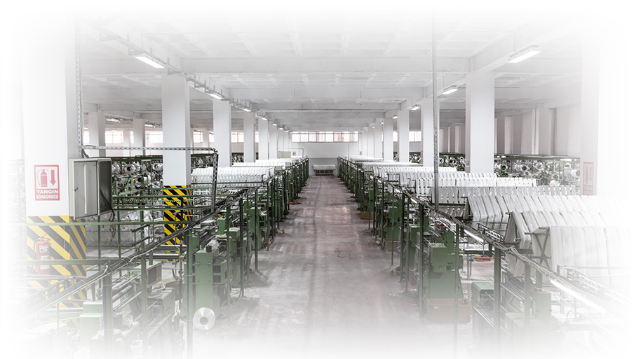
Industrial Luminaries
High Bay Luminaries / Workshop Luminaries
Canopy Luminaries / Waterproof Luminaries

Slide 18
Lamps

Slide 19
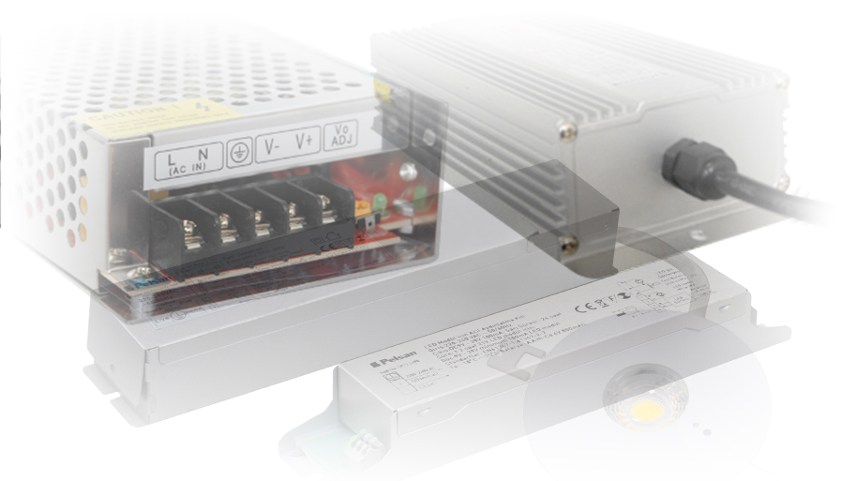
Equipment
LED Drivers / Emergency Lighting Unit

Slide 20
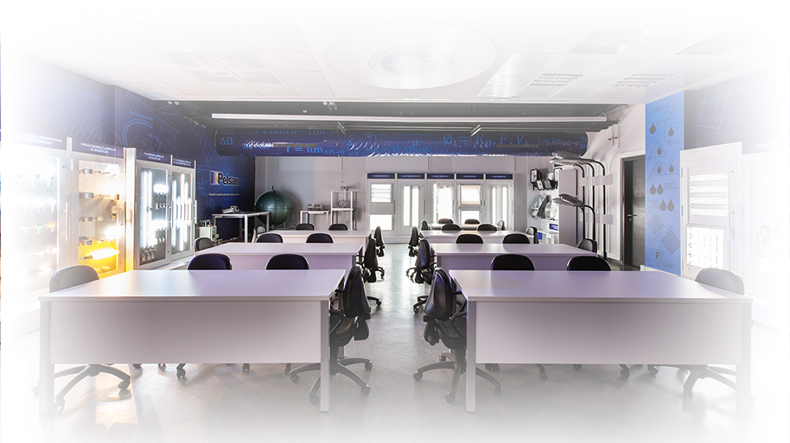
Under the cooperation with universities,
Lighting Laboratories have been established at Kocaeli University and Yıldız Technical University and we invest for the future of the young people.

Slide 21
With Pelsan Aydınlatma Management Trainee Program (PMTP)
we prepare students into professional life by offering work and
intern opportunities to them under Pelsan‘ s light.

Slide 22
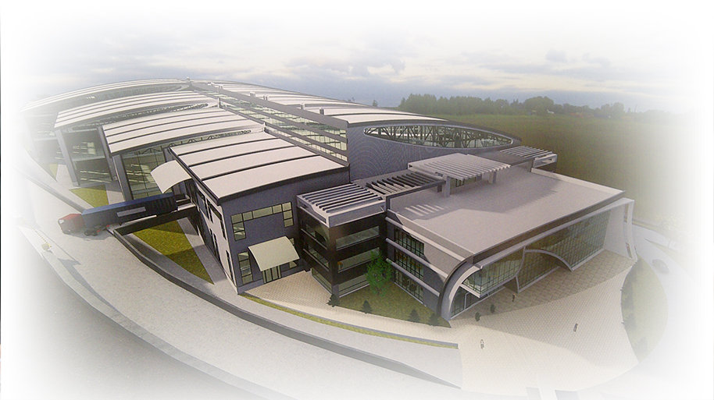
During the first quarter of 2016,
we are planning to move to the new factory of Pelsan Aydınlatma which we believe to change all dynamics in the industry.

